Slide 1
Weekly report: Machine Bed & Yaw System
Week No - 9
Date: 25.11.2025
Supervisor: Prof. Peter Quell
Shoukat Abbas, Luksh Chawla, Sathishkumar Venkatachalam, Shrihari G Kadam
Presented by – Shoukat Abbas

Slide 2
Contents
Yaw Bearing Finalization
Yaw Brake finalization
Yaw Brake CAD Model
Number of brake callipers
Brake Caliper Selection
References
Shoukat Abbas

Slide 3
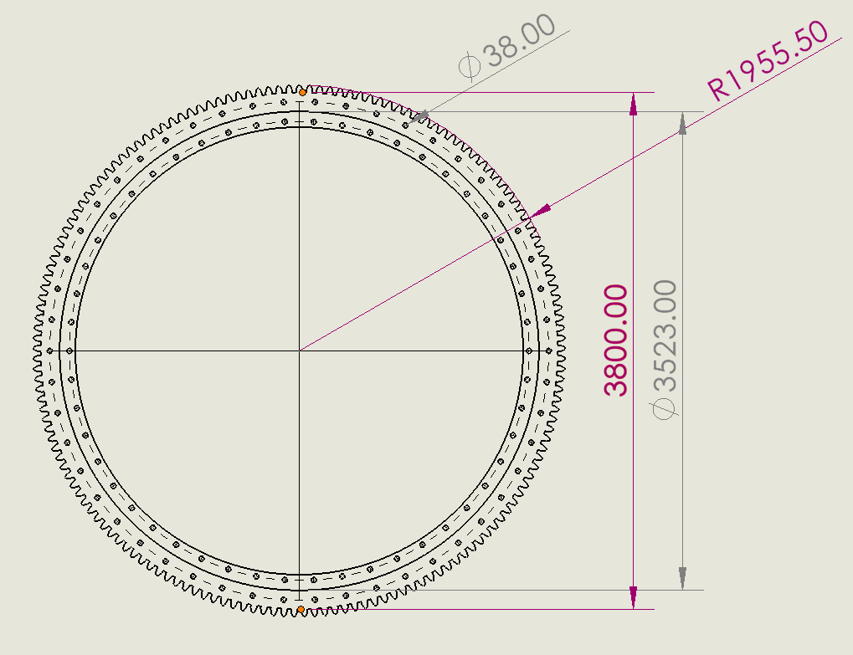
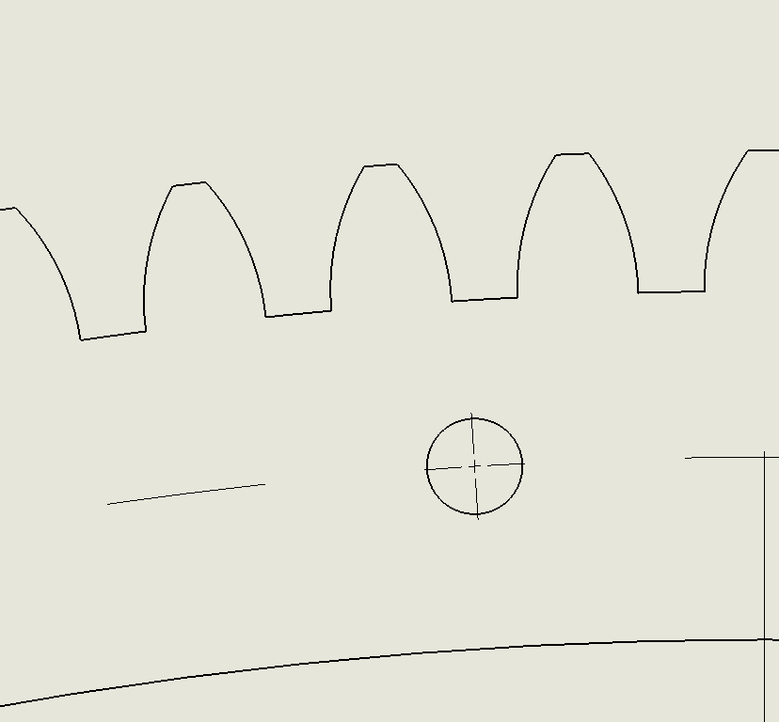
Yaw Bearing 2D Drawing
Double-row four-point bearing with External Gears
2D drawing from own 3D part
Teeth Profile
Shoukat Abbas

Slide 4
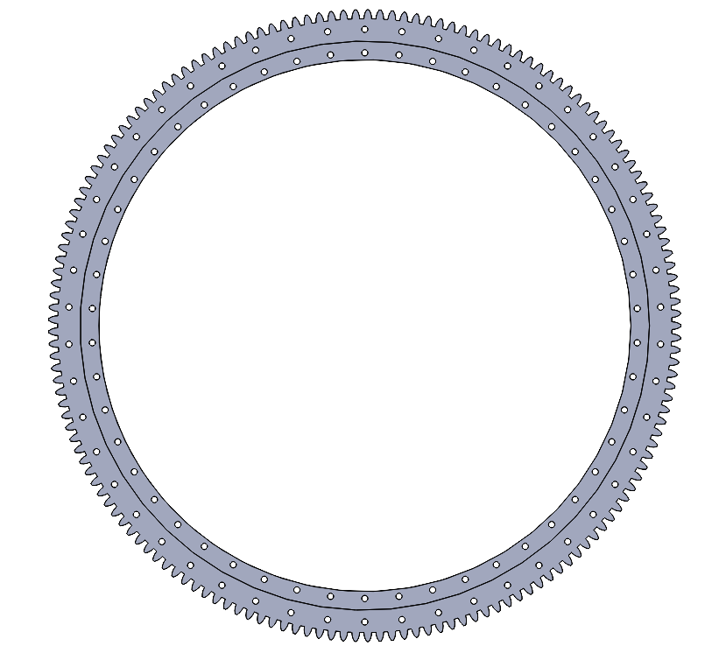
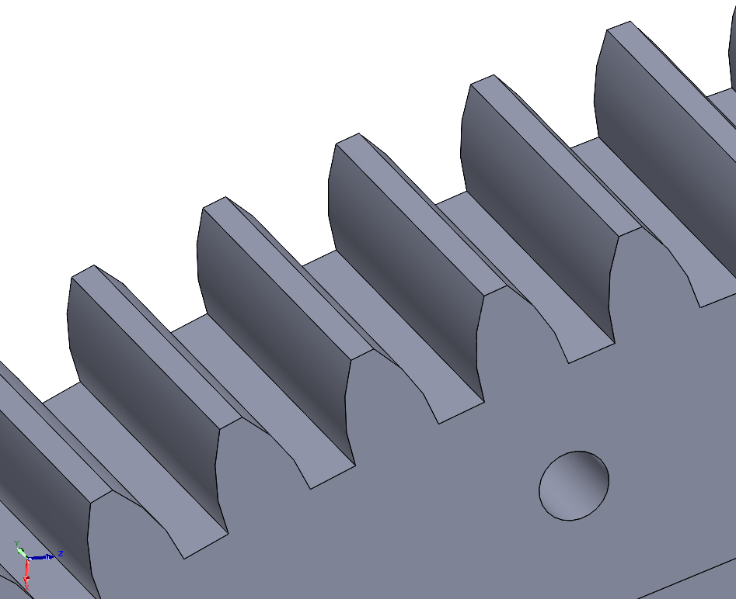
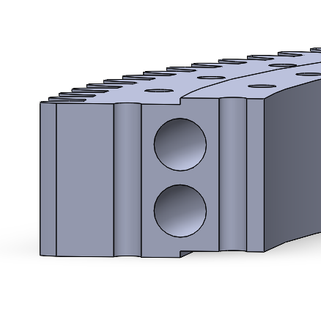
Yaw Bearing 3D Model
Top view
Tooth profile close-up
Cross-sectioned view
Shoukat Abbas

Slide 5
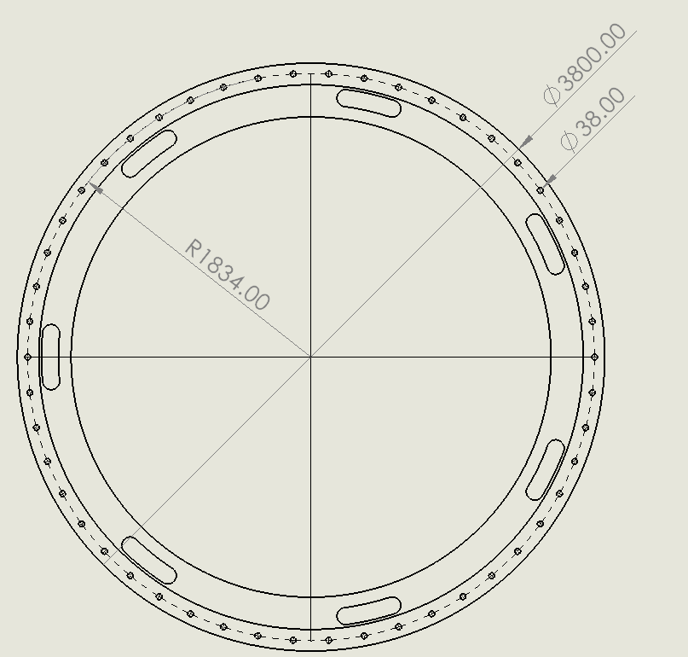
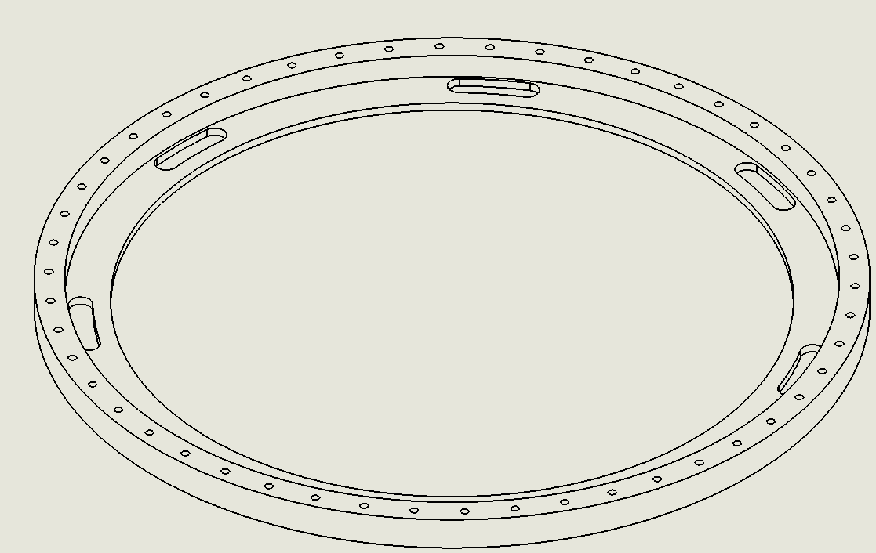
Yaw Brake Finalization
Yaw brake disk
2D drawing from own 3D part
Isometric view 2D
Shoukat Abbas

Slide 6
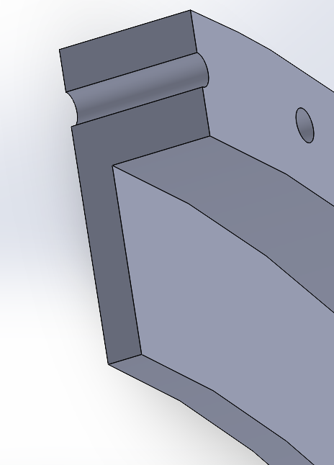
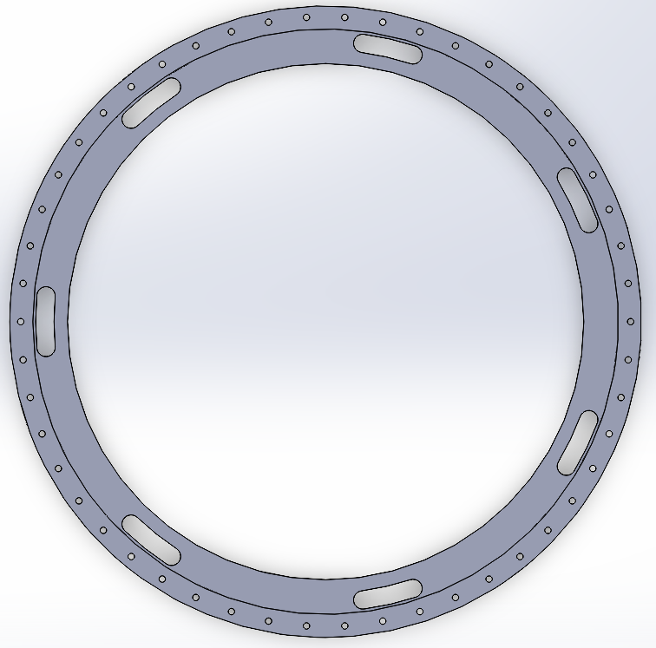
Yaw Brake CAD Model
Holes are aligned with the Yaw Bearing.
Top view CAD
Cross-section view
Shoukat Abbas

Slide 7
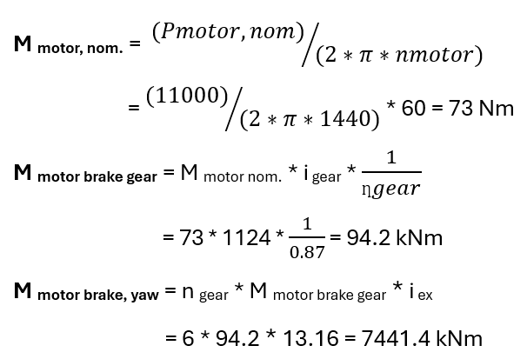
Motor brake Yaw Torque calculation
Calculation motor brake yaw torque:
Shoukat Abbas

Slide 8
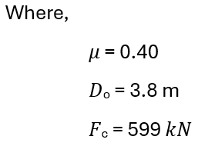

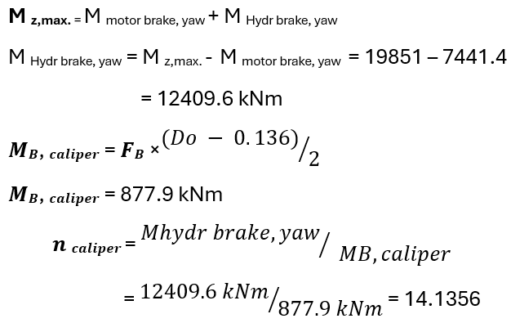

Number of brake Calipers calculation
Shoukat Abbas

Slide 9
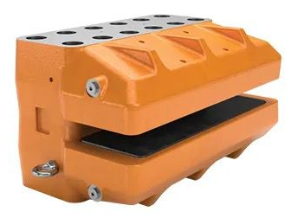
Brake Calipers selection
BSAB 120 brake from Svendborg Company.
Svendborg BSAB120
Source: Svendborg-brakes/hydraulic-brakes
[1], [2]
Shoukat Abbas

Slide 10
Yaw Brake Disk and Brake Calipers
Yaw brake Svendborg BSAB 120 - Specification
Brake Pad:
Pad width: 138 mm
Pad area (organic): 50,000 mm²
Maximum pad wear (organic): 7 mm (pad thickness = 14 mm)
Nominal friction coefficient: µ = 0.4
Hydraulic Characteristics:
Total piston area (each caliper): 678.6 cm²
Hydraulic Volume:
Volume per caliper at 1 mm stroke: 67.8 cm³
Volume per caliper at 3 mm stroke: 203.5 cm³
Operating Pressure:
Maximum operating pressure: 16 MPa
Operating Conditions
General temperature range: –20°C to +70°C
Wind turbine temperature range: –40°C to +60°C
[1], [2]
Shoukat Abbas

Slide 11
References
    [1]. Hydraulic brakes Svensborg brakes, https://www.svendborg-brakes.com/products/hydraulic-brakes/active-brakes/bsac-120/ (accessed: 13.11.2025)
    [2]. Hydraulic brakes Svensborg brakes, Svendborg-brakes /product-catalogue/ (accessed: 13.11.2025)
Shoukat Abbas

